Slide 2
Metataxonomics
Mikael Lenz Strube milst@dtu.dk

Slide 3
The Taxonomic Analysis workshop

Slide 4

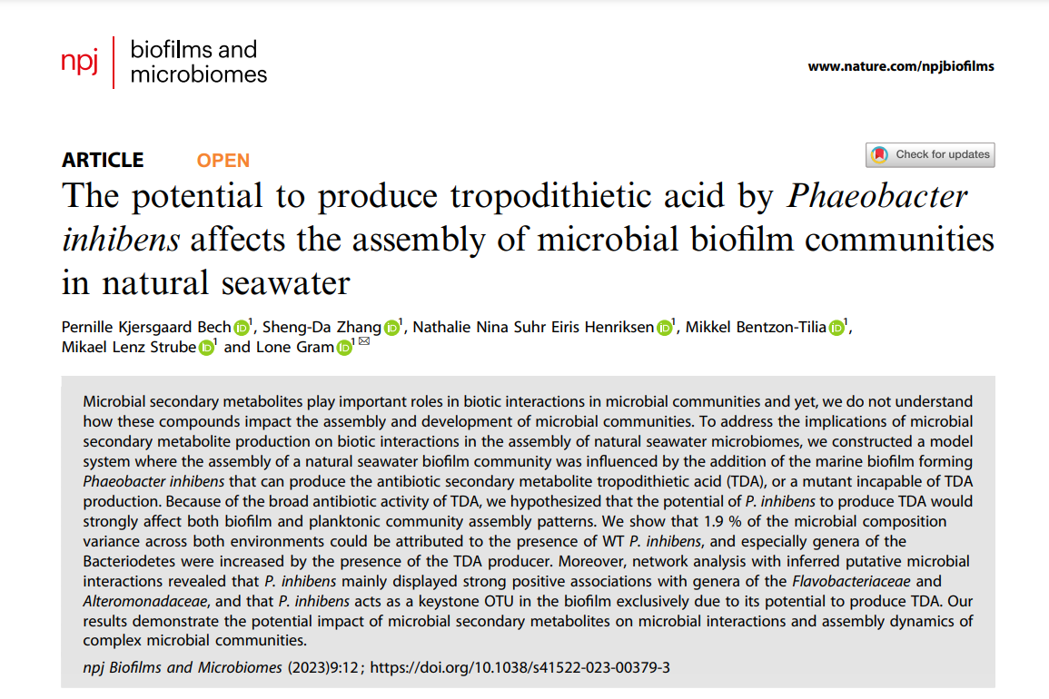

Slide 5
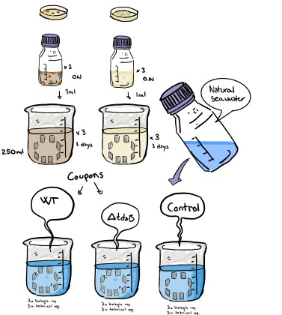
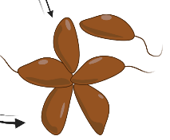

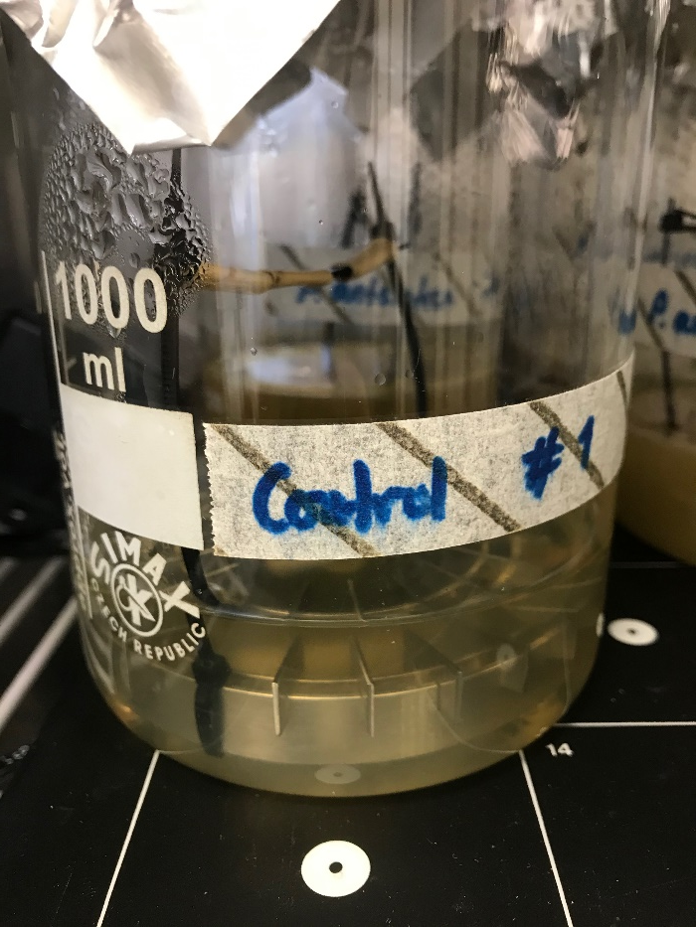
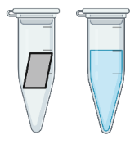
Experimental setup:
DNA extractions, V3V4 16S rRNA gene amplification and sequencing of the biofilm and the planktonic suspension at Day 0, 1, 4 and 10

Slide 6
What is interesting?
The abundance of individual bacteria?
The diversity of bacteria?
The pattern of bacterial abundance?
What to compare?
Always remember the biology!

Slide 7
Diversities
beta
beta
alpha
alpha
Within-sample
Within-sample
Between-sample
Between-sample
Omega

Slide 8
Alpha-diversity
Higher alpha diversity is usually good!
If you only have 1 bacteria in your gut you will likely die soon
If you have many different, you can likely digest most things
Richness
How many bacteria are in the sample?
Shannon
Both how many bacteria and how evenly they are distributed

Slide 9
Beta-diversity
”I want to see if something is different”
Around a 100 people having stopped by my office
The fingerprint of each sample versus the fingerprint of another

Slide 10
Sample distance
Samples can be compared by their distance to one another
Distance can be considered simply as the eucledian distance between points
In 2D, this is just a simple pythagoras
c
a
b

Slide 11
Sample distance
Samples can be compared by their distance to one another
Distance can be considered simply as the eucledian distance between points
In 3D, this is just an extensíon, but becomes hard to visualize beyond 3D
c
a
b

Slide 12
Sample distance
Samples can be compared by their distance to one another
Distance can be considered simply as the eucledian distance between points
In k-D, this is conceptually another extensíon, but becomes hard to visualize beyond 3D
In modern analysis, we use PCoA or nMDS to collapse ~10,000 dimensional data to visualize complex data in 2- or 3D

Slide 13
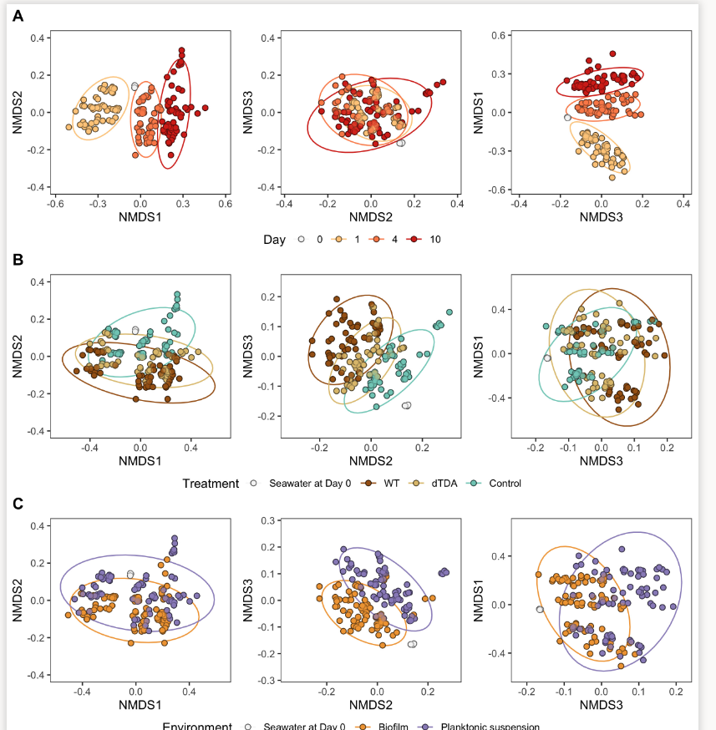
TIME
1000 of bacteria (variables)
TREATMENT
TYPE
Pernille Bech
PhD
‘The capability to produce tropodithietic acid by
Phaeobacter inhibens affects the assembly of
microbial biofilm communities in natural seawater’
-Biofilms and Microbiomes

Slide 14
Sample distance
Samples can be compared by their distance to one another
Distance can be considered as the overall difference between samples, given the choice of distance metric
Alternatively, distances can be considered phylogenetically rather than as abundance profiles - e.g. how different are the samples when you include the phylogeny of the members of the samples

Slide 15
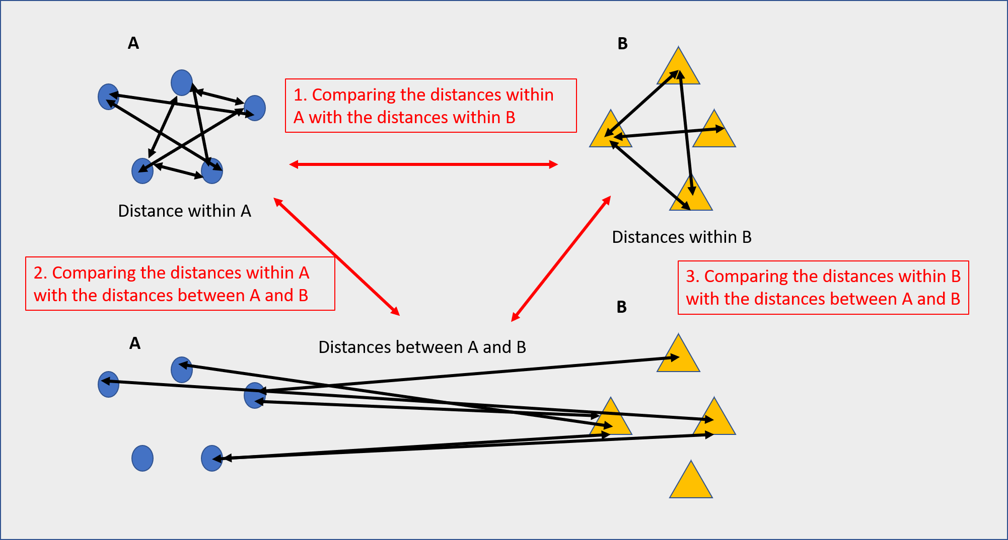
Beta-diversity
Differences can be tested by PERMANOVA
PERMutational ANalysis Of Variance

Slide 16
Pairwise comparisons
Univariate data
”Is the number of Lactobacillus in group A higher than in group B?”
Depends on number of groups and design
2 groups: t-test
2+ groups: ANOVA
Higher order designs: GLMs
Needs normally distributed data
Try a log-transform if not
Multivariate data
PERMANOVA

